Slide 1
RCJ Service Project Committee
Report and Action Plans
June 19,2022 (Joint Club Assembly)

Slide 2
We served to change lives
USG/ECG handover under Global Grant
Computer Competency Class
Pregnancy Education
Tree Plantation
Preparation of new global grant
Review of past projects

Slide 3
USG/ECG handover (GG 2010836)
4-5-6 (Four countries, Five Clubs, Six health centers of Six districts)
USG/ECG/Consumables were handed over, training was done, monitoring of the usefulness was continually done
Effectiveness is observed by increased patient flow, increasing use of equipment
All six mayors and hospitals staffs were present in all the programs
All of our members showed enthusiastic participation
Collaboration was done with local Rotary Clubs (RC Dang, RC Central Butwal, RC Bhairahawa)

Slide 4
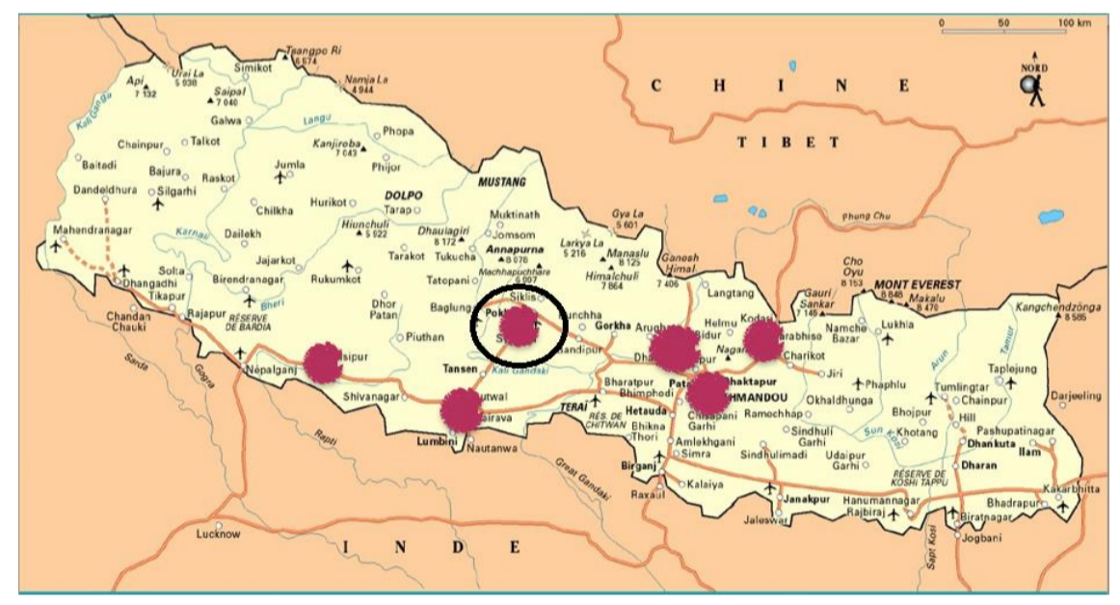
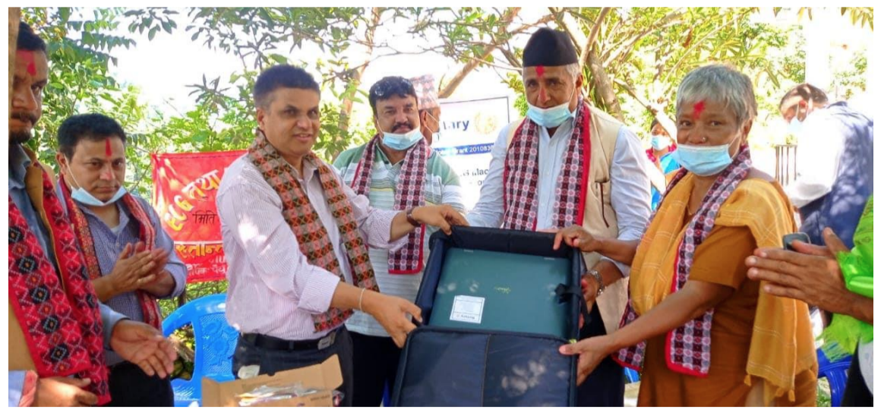
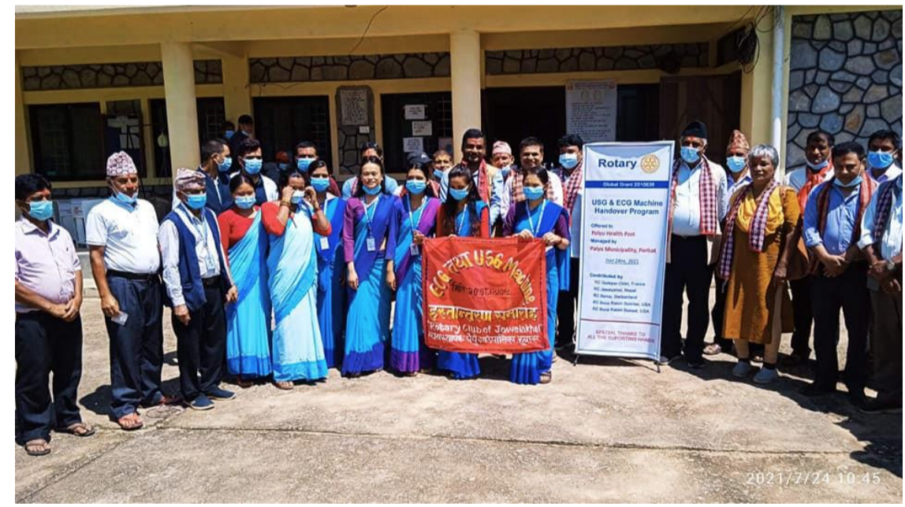
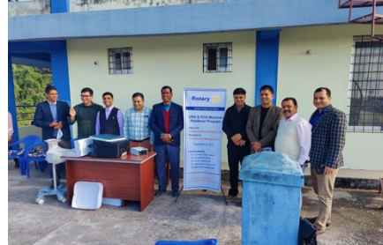
True essence of Service Above Self

Slide 5
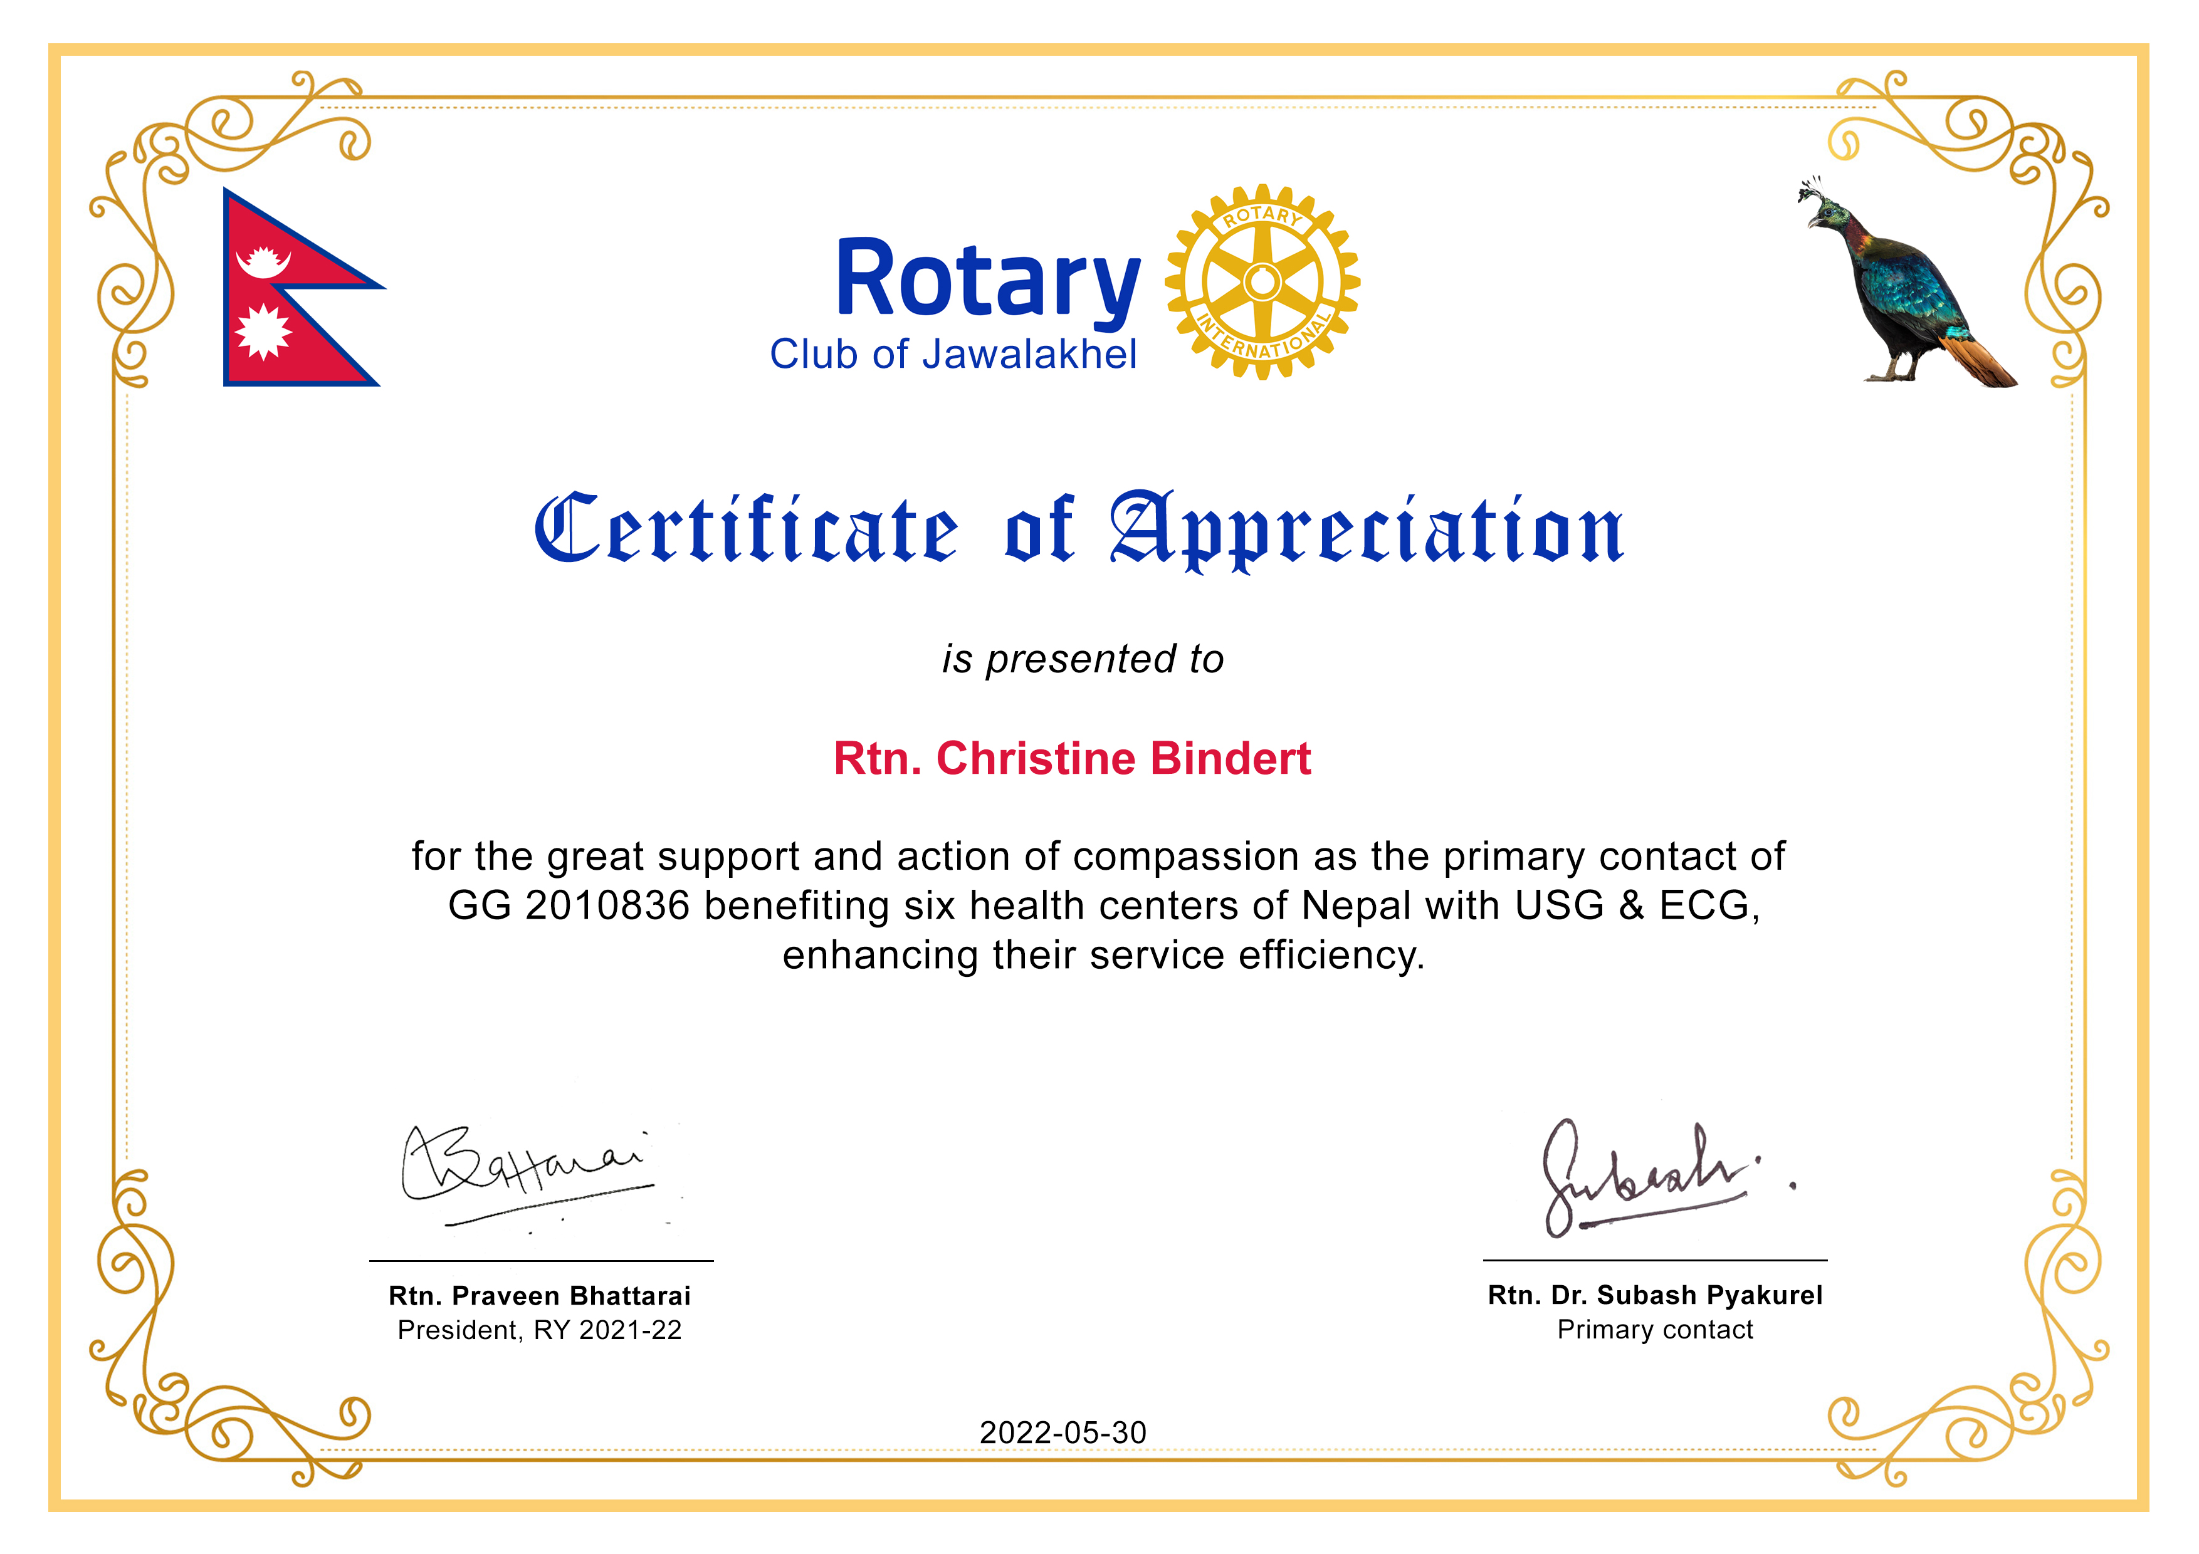
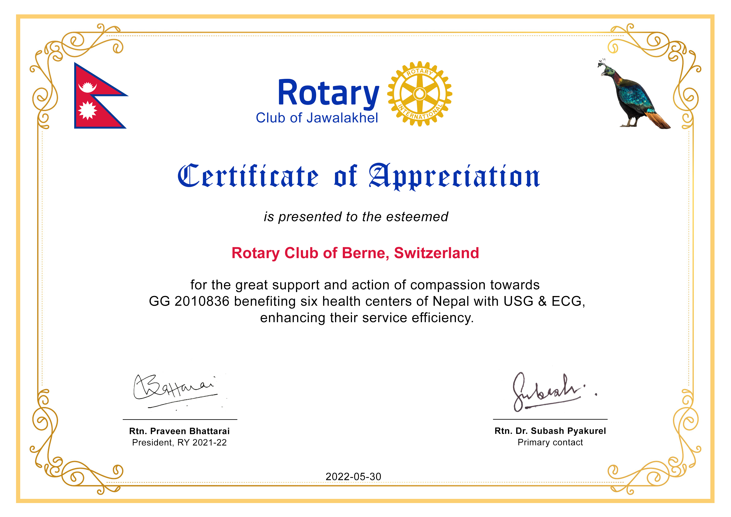
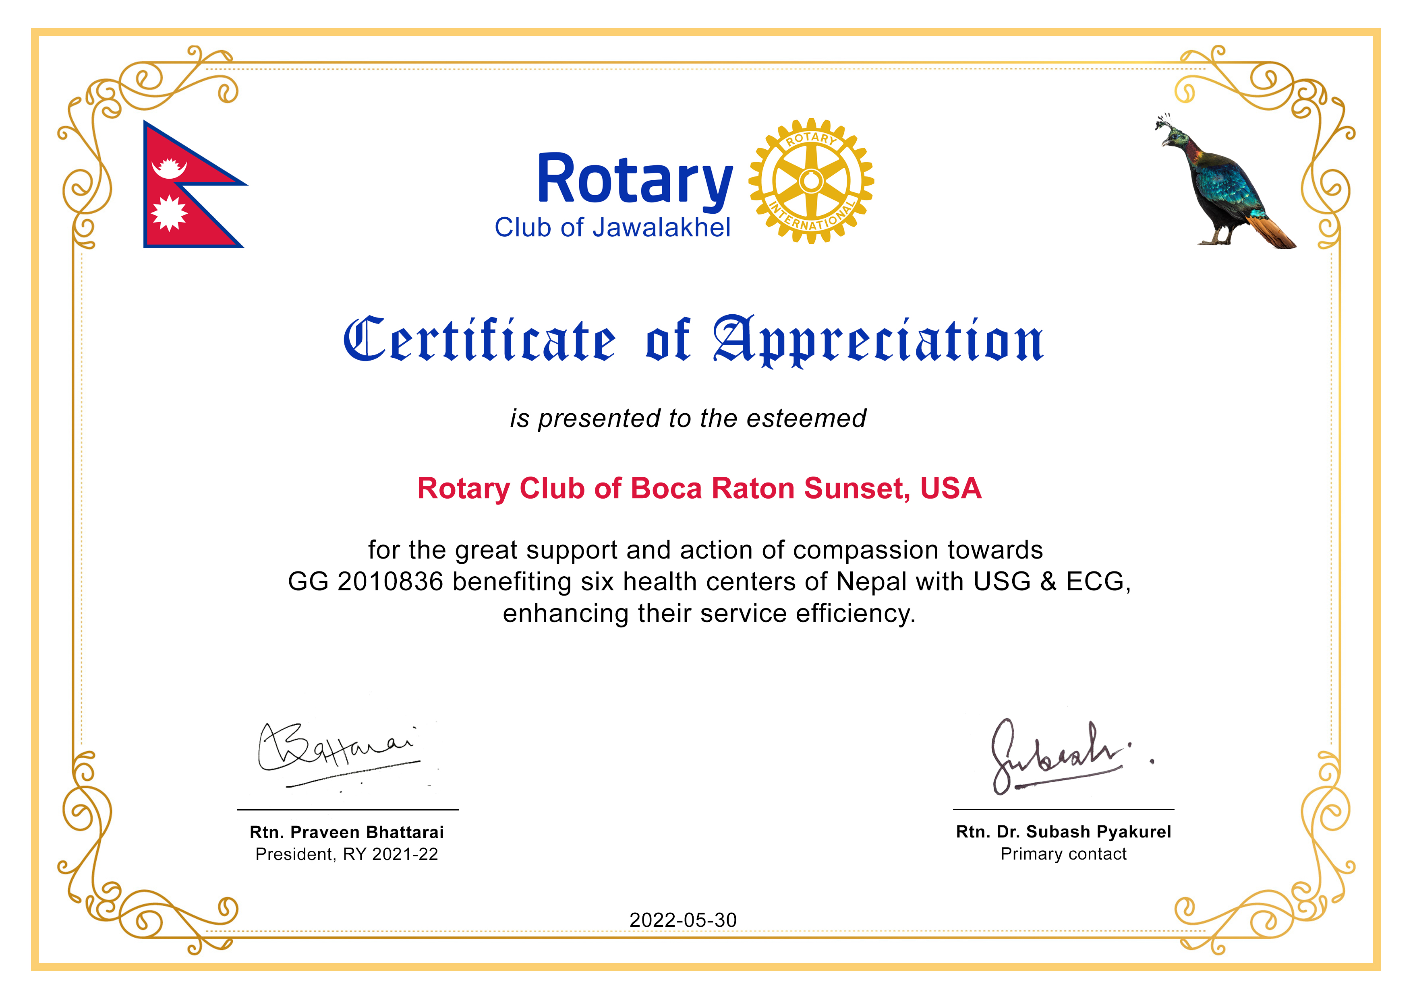
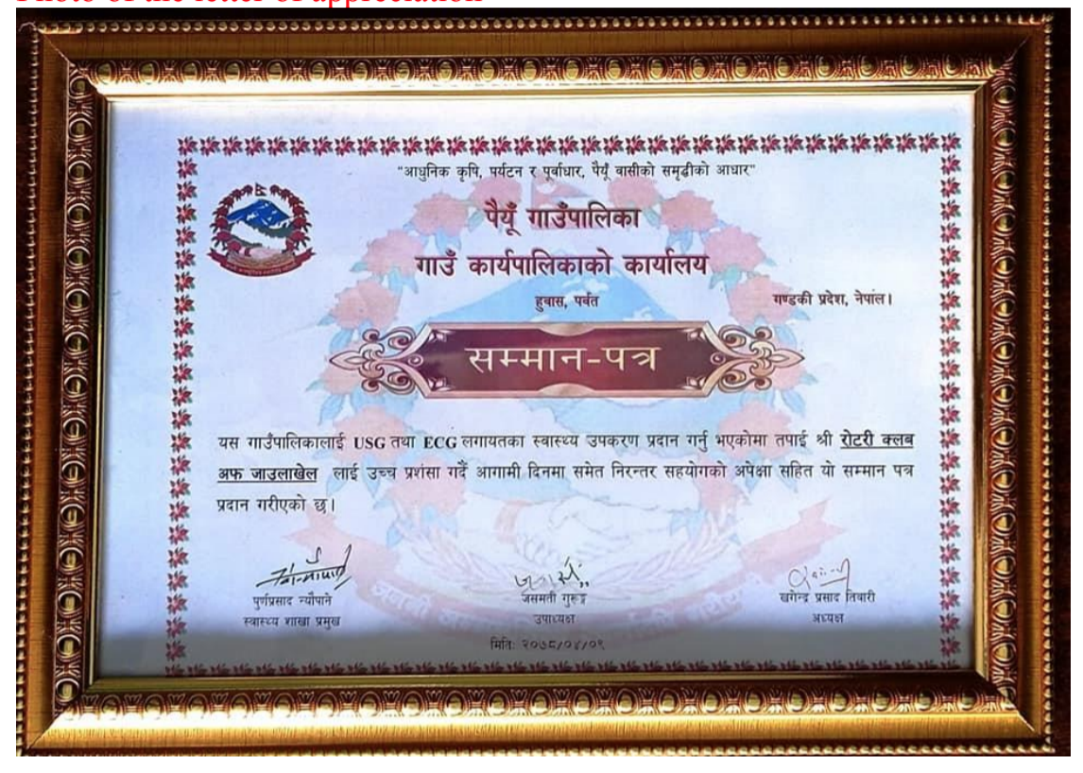
Feeling of gratitude

Slide 6
Computer Competency Class
Twenty Rotaractors from both of our Rotaract clubs (Jawalakhel and NNH) participated, supported in coordination and management as well
Jointly done by Service Project Committee and Youth Service committee
Through a day long session, Photopea(Online Photoshop) was trained, both theory and practical by expert mentor

Slide 7
Pregnancy Education
Pregnant women and Female Community Health Volunteers were trained by expert using various methods in a day long program in Nuwakot
In coordination with Rotaract Club of NNH, Nepal National Hospital and Bidur Municipality
This was topped up by relevant stuffs distribution

Slide 8
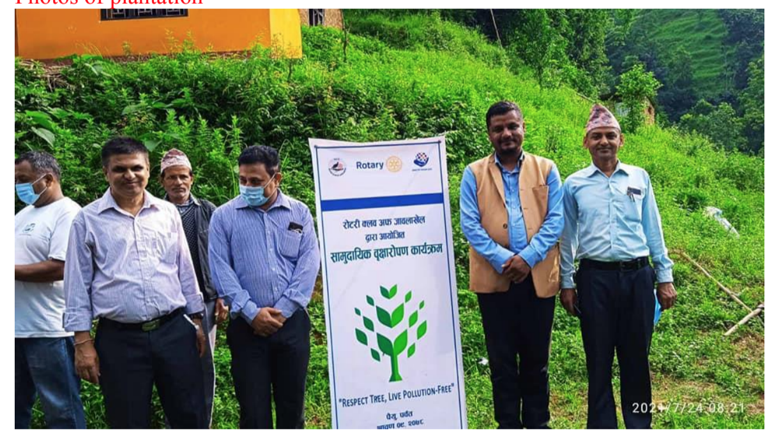
Tree Plantation
Respect Tree, Live pollution free
Fruits trees were planted in Paiyu, Parbat
Supported by local organizations
Followed by knowledge sharing on Rotary, feedback from the community

Slide 9
Imagine Rotary: Our Action Plan for RY 2022-23
Women Empowerment through skill development
Health Center Digitization Project
My Career Vision
Adolescence Education
Intercollege art competition on environment protection
Computer Competency Class
Next Page…

Slide 10
Contd..
Showcasing of ICT tools for visually impaired people
Interaction on Disability Issues
Bosia Game
Road Safety Project
Pregnancy Education
Rotary Box of Knowledge
Service Above Self/ Our project, our pride
Toilets construction project

Slide 11
Thematic Philosophy: ‘SERVICE’
S: Selflessness
E: Engagement
R: Requirement/Review/Report
V: Versatilty (Many focused areas, many communities)
I: Innovation/Impact/Image
C: Continuity
E: Effectiveness
Team:
Adviser- Rtn. Hema Adhikari, Co-chair: PE Rtn. Hikmat Chand
Members: Rtn. Jagat Man Shrestha, Bhesh Raj Thapa,
Invitee members: Rtn. Reshu Dangi (Youth service chair),
Rtn. Ichchha Lamichhane (Public Image chair)

Slide 12
Punching Words
SUPPORT FROM EVERYONE WILL BE OF HIGH VALUE
THANK YOU FOR BEING TOGETHER

